Slide 1
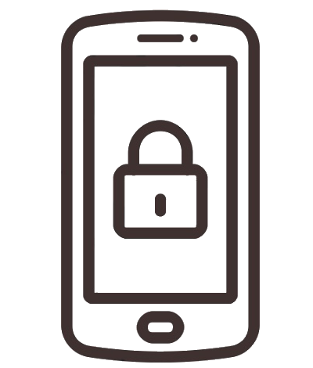
Mobile Device Security
Lorrin Johnson
Notes:
Hi. My name is Lorrin Johnson
This is my first semester in the cybersecurity and information assurance master’s degree program
And my service-learning project topic is mobile device security

Slide 2
Table of Contents
Introduction to Service-Learning
Mobile Device Security
Introduction to mobile device security
Mobile device security importance
Benefits of mobile device security
Last Thoughts and Helpful Tips
Contact Information
References
Frequently Asked Questions
Mobile device security best practices
Types of mobile device security
Maintaining security
Notes:
For this assignment, I will introduce service-learning, review the details of mobile device security, share helpful tips, and answer FAQs

Slide 3
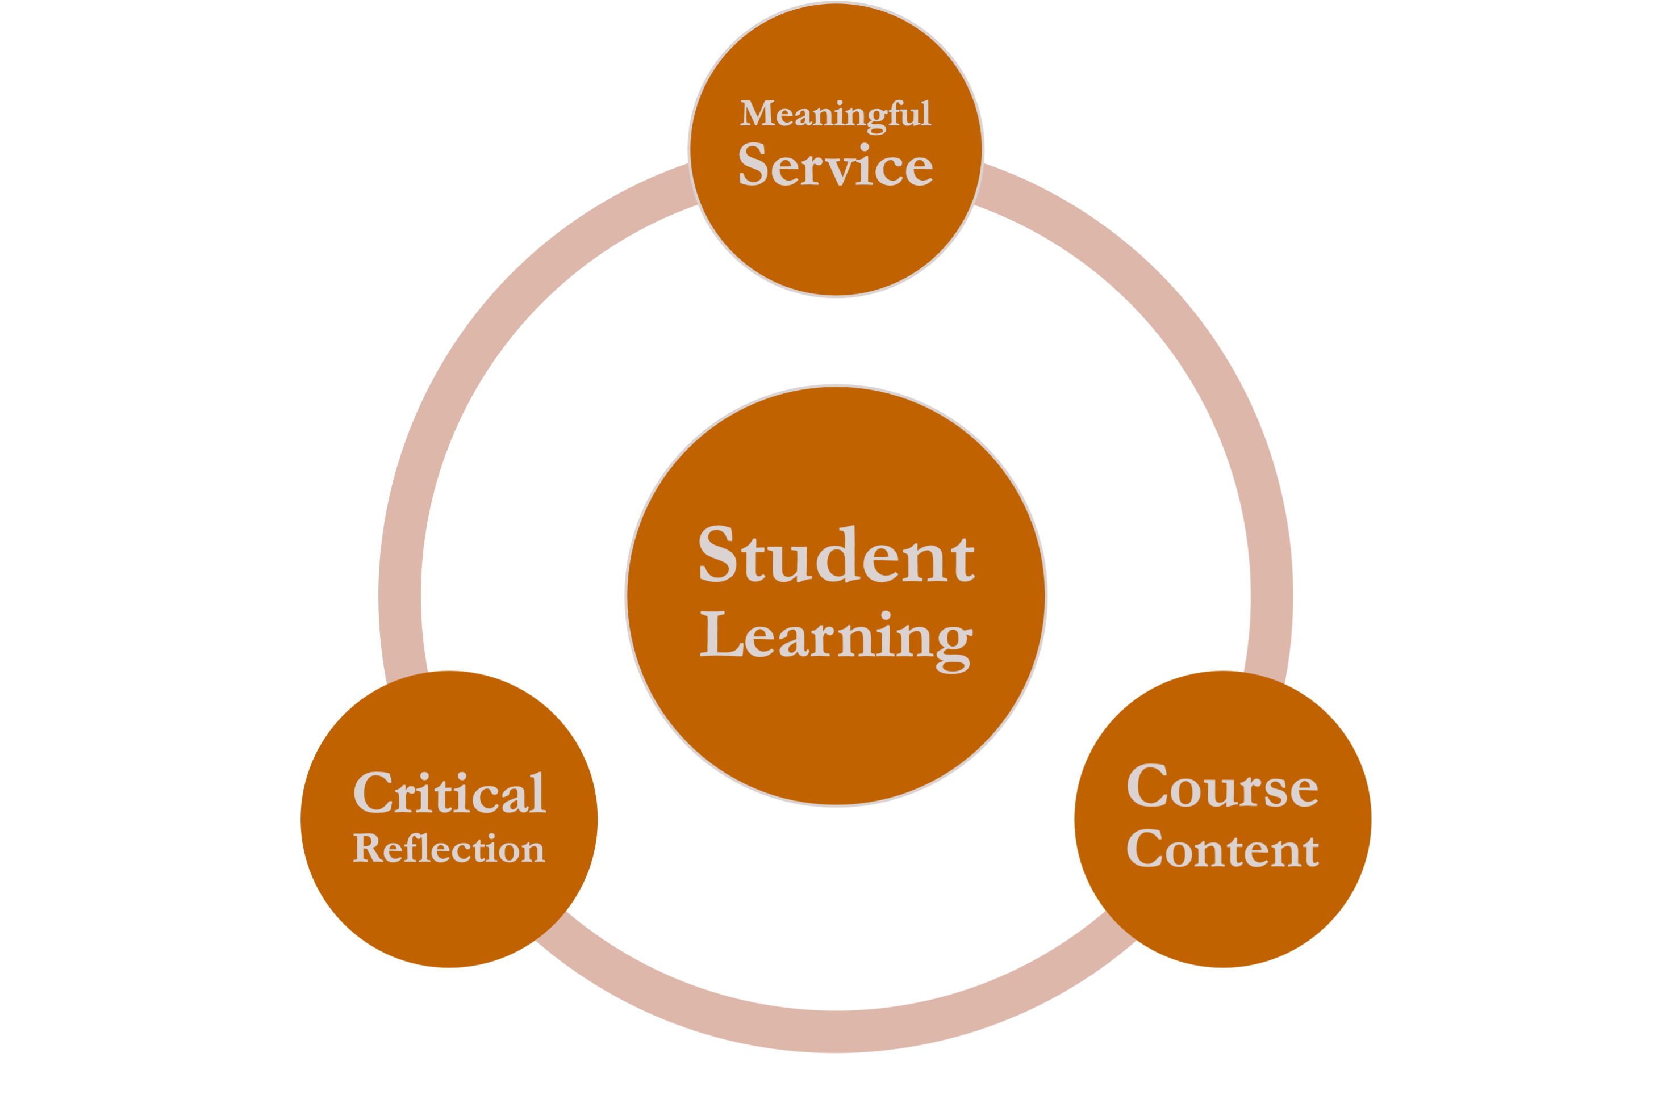
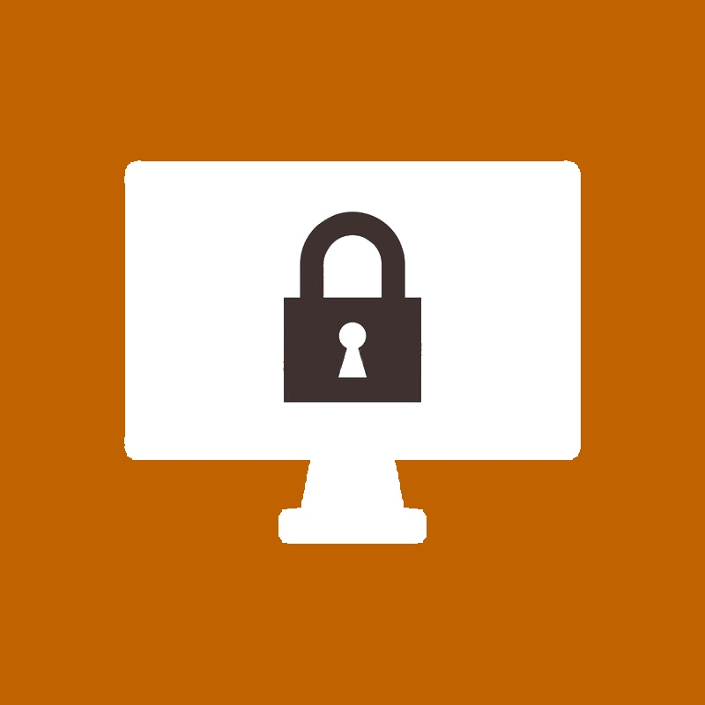
Introduction to Service-Learning
Service-learning engages students in direct service, reflection, and integration as an essential part of the course learning objectives.
Working in data analytics, technology is our primary resource.
Any interruptions in our process would cause several issues so it is important to maintain secure devices through best practices.
Notes:
Service-learning works in conjunction with direct and meaningful service, critical reflection, and integration of course content to engage students
I chose this topic because I currently work in analytics and tech is our main resource
If a compromise occurred, we would not be able to get any work done
So it is important to maintain secure devices through best practices

Slide 4
Introduction to Mobile Device Security¹
Mobile device security includes the measures designed to protect sensitive information stored on and transmitted by laptops, smartphones, tablets, and other portable devices.
The goal is to keep unauthorized users from accessing the network.
Notes:
Read slide

Slide 5
Mobile Device Security Importance
As mobile devices become more popular in the workplace, distinct challenges to network security are present.
Potential threats to mobile devices:
Malicious mobile applications
Data leaks
Scams from phishing
Spyware
Unsecure Wi-Fi networks
Insider threats, intentional and unintentional
Notes:
Maintaining mobile device security is more important than ever before
First paragraph
Potential threats to mobile devices

Slide 6
Benefits of Mobile Device Security
Regulatory compliance
Enforcement of security policy
Incorporation of BYOD – bring your own device
Device updates controlled remotely
Control of applications
Device registration automation
Automated data backup
Protects from malicious attacks from being able to access sensitive information from the organization
Notes:
Benefits – read slide

Slide 7
Mobile Device Security Best Practices²
Establish, share and enforce clear policies and procedures
Password protection and training
Incorporate the use of biometrics
Avoid public Wi-Fi
Beware of external applications
Mobile device encryption
Notes:
Establish - companies should be sure that policies are properly communicated to employees including
what devices can be used,
what employees can and cannot access on a personal phone,
where IT can remot4e into devices,
password requirements,
and anything else
Password – organizations are still having issues reinforcing the criticality of password strength and uniqueness – employees must create secure passwords and create different passwords for each account
Biometrics – beef up security by incorporating biometric authentication
When a computer uses biological characteristics – face, fingerprint, voice, iris – for identification and access
WiFi – companies can provide training to educate employees about public WiFi networks – usually vulnerable to attacks from hackers who can easily breach a device, access the network and steal data
Beware – malicious apps can gain unauthorized access to the company’s network and data
Last – with encryption, data is converted into a code that can only be accessed by authorized users

Slide 8
Types of Mobile Device Security¹
Email Security
Endpoint protection
VPN – virtual private network
Secure web gateway
CASB - Cloud access security broker
Notes:
Email – most popular way for hackers to spread malware – email security is used to prevent data loss and protect the information in transit
Endpoint – used to protect enterprise networks that mobile devices remotely access - protects companies by ensuring portable devices follow security guidelines and quickly alerting security teams if threats are detected
VPN – extends a private network over a public network – allows remote users to securely access company assets
Secure – used to protect against online security threats by enforcing company security policies and defending against phishing and malware in real-time
CASB – used to enforce security, compliance and governance policies for cloud applications – helps companies extend security controls of their infrastructure to the cloud

Slide 9
Maintaining Security¹
Do's
Don'ts
Do not connect to public, and untrusted, Wi-Fi networks
Do not install several unnecessary applications or enter personal data
Do not perform work actions including sensitive information on personal devices
Do not jailbreak or root your mobile device
Update mobile device software and applications automatically or when available
Use strong and complex pins and passwords
Consider the use of biometric authentication
Protect devices with cases that help to drown microphones and block audio in the room
Do not connect to public, and untrusted, Wi-Fi networks
Do not install several unnecessary applications or enter personal data
Do not perform work actions involving sensitive information on personal devices
Do not jailbreak or root your mobile device
Notes:
Read slide – don’t need to read all and maybe summarize most

Slide 10
Last Thoughts/Helpful Tips
Always lock device when not in use
Don’t open suspicious emails from external addresses
Always back up mobile device data
Don’t download third-party applications without company approval
Always enable two-factor authentication
Don’t use the same password for every account
Notes:
Here’s just a few tips that might help maintain a secure mobile device

Slide 11
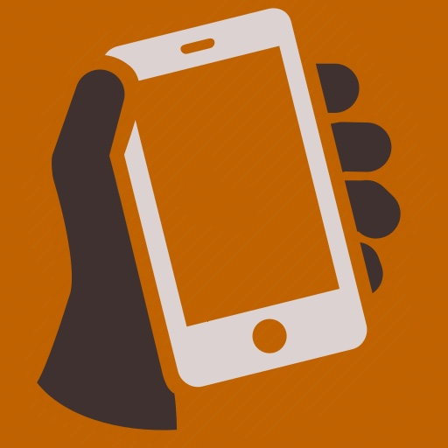

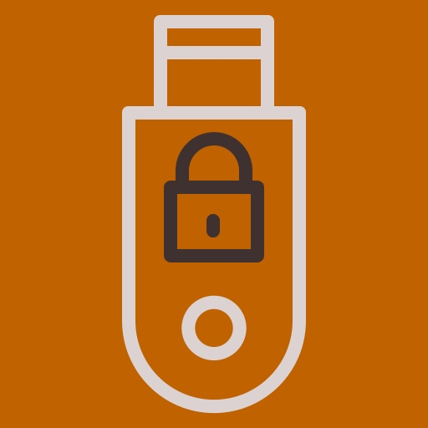

Frequently Asked Questions³
What qualifies as a mobile device?
Any small device that can process and store data. Examples include laptops, smartphones, tablets, and PDAs.
What are the company password requirements?
This depends on the company, but usually a complex mix of at least eight characters.
Can I use an encrypted USB drive to store company data?
Most storage drives are accepted, but encryption must first be verified by the company.
What if my device is stolen?
Immediately report the incident so the device can be deactivated.
Notes:
Here are some frequently asked questions on this topic
Read each and answer each

Slide 12
Contact Information
UDM Center of Academic Excellence in Cyber Defense (CAE-CD)
Gregory Laidlaw
Lecturer
Department Chair and Program Director, Cybersecurity and Information Systems
University of Detroit Mercy
laidlags@udmercy.edu
Professor Anne Kohnke, Ph.D.
Associate Professor
Cybersecurity and Information Systems Department (C&IS)
Principal Investigator of the Center of Academic Excellence in Cyber Defense (CAE-CD)
Director of the Center for Cyber, Security and Intelligence Studies
University of Detroit Mercy
kohnkean@udmercy.edu
Notes:
Here is the contact information for my cyber defense operations professor, Anne Kohnke, and the center of Academic Excellence in cyber defense

Slide 13
References
What Is Mobile Device Security? Cisco Small Business Resource Center. Source: https://www.cisco.com/c/en/us/solutions/small-business/resource-center/security/mobile-device-security.html
Mobile Device Best Practices. National Security Agency (NSA). Source: https://media.defense.gov/2021/Sep/16/2002855921/-1/-1/0/MOBILE_DEVICE_BEST_PRACTICES_FINAL_V3%20-%20COPY.PDF
Mobile Device Security FAQ. University of Florida, Information Security. Source: https://security.ufl.edu/resources/mobile-device-security/mobile-device-security-faq/

